Slide 1

Capstone Project 2:
Movies
Produced by: Nor Aza
Credit: https://www.dreamstime.com/stock-illustration-frame-film-grungy-photo-frame-free-copy-space-vector-illustration-image62600340?gclid=CjwKCAiAqJn9BRB0EiwAJ1SztXcAnIGsfOsHzxsx9DiUnO20bay0msvl5EFttFtax1jJJnpnQanWmBoCi4sQAvD_BwE

Slide 2

Table of Contents
Data collection
ER Diagram
Data Preparation (cleaning + transformation)
Data Analysis using SQL
Excel Dashboard
Conclusion

Slide 3
Data Collection

Slide 4
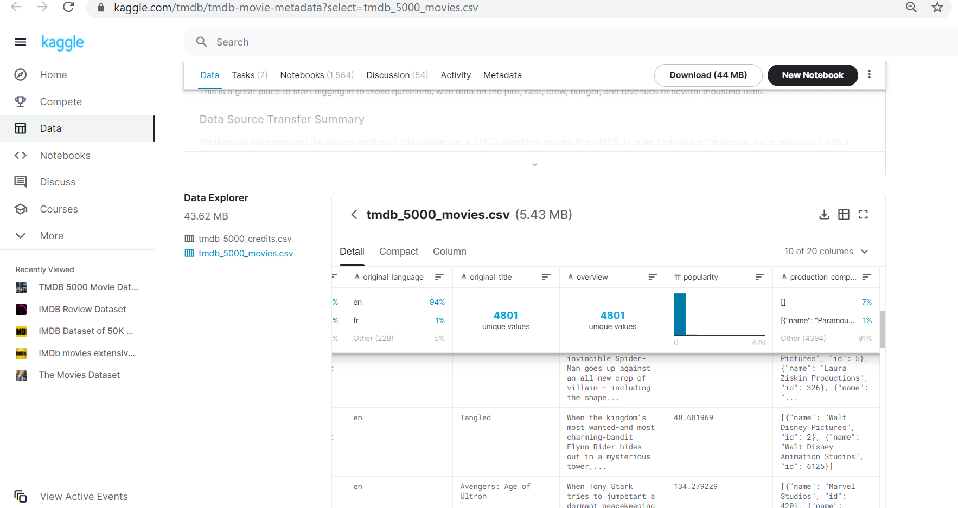
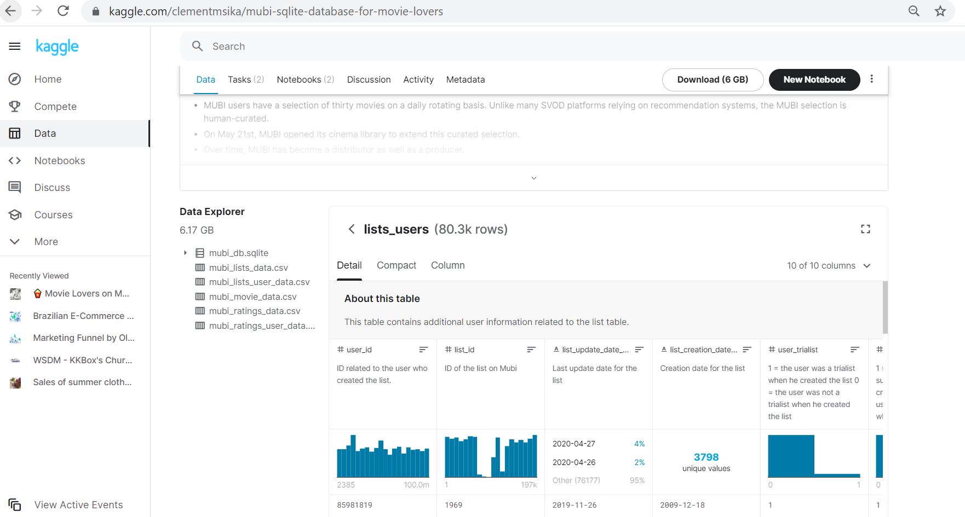
Obtaining Datasets
From Kaggle websites:
MUBI DATABASE FOR MOVIE LOVERS: https://www.kaggle.com/clementmsika/mubi-sqlite-database-for-movie-lovers
The Movies DB 5000 Movies: https://www.kaggle.com/tmdb/tmdb-movie-metadata?select=tmdb_5000_movies.csv

Slide 5
ESTABLISHING ER DIAGRAM

Slide 6
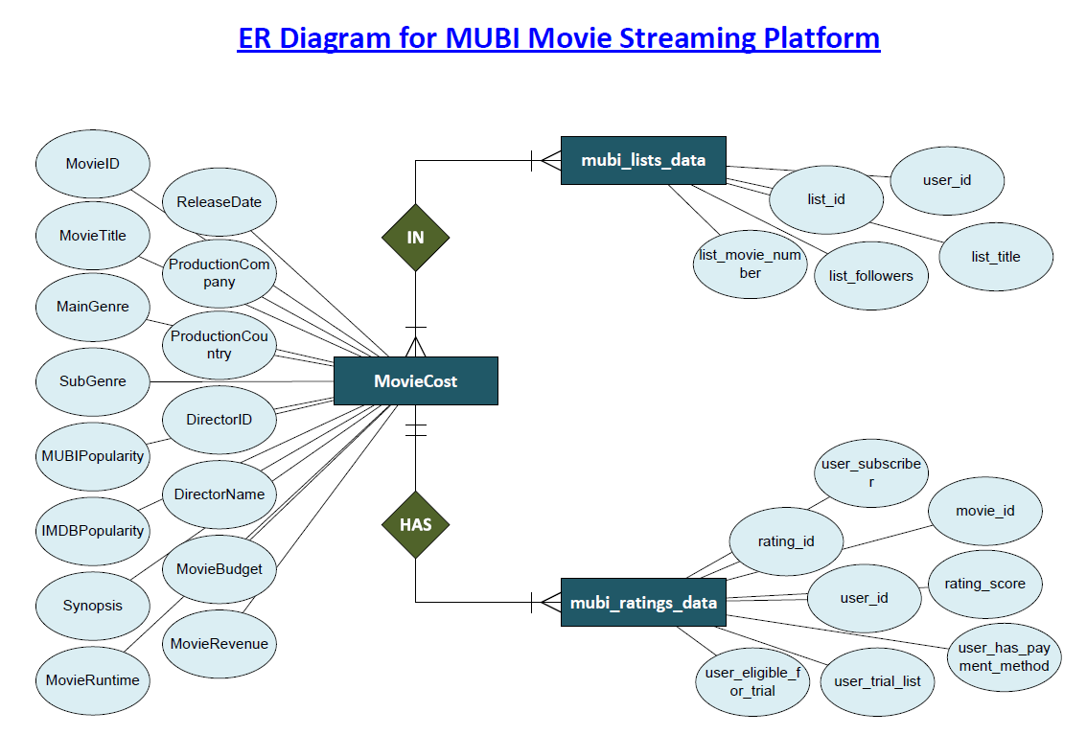

Slide 7
Data Cleaning Using SQL

Slide 8


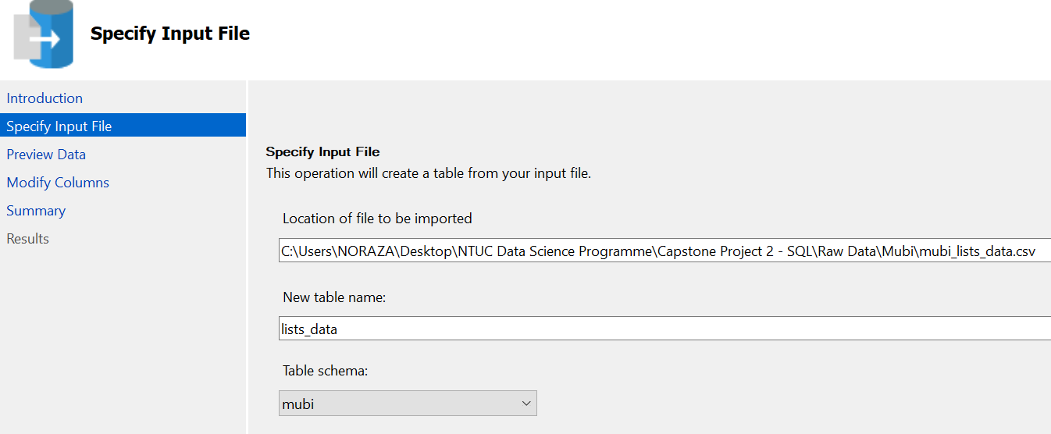
Creating New DB & Schema: mubi
New Database
Import CSV files into MSSQL
New Schema

Slide 9
Cleaning + Transformation
CREATE new DATABASE and new SCHEMA name
Upload datasets to SQL
ALTER tables to DROP redundant COLUMNS in tables
EXEC in-built sp_rename to rename the columns in tables proper
INNER JOIN 2 tables to CREATE new table MovieMoney
Using WHERE clause AND for various conditions to DELETE NULL values in certain columns
Assumption the first name in the record per column is the Main data/contributor to the movie
ALTER TABLE mubi.lists_data
DROP COLUMN
list_update_timestamp_utc,
list_creation_timestamp_utc,
list_url,
list_comments,
list_cover_image_url,
list_first_image_url,
list_second_image_url,
list_third_image_url;
EXEC sp_rename 'mubi.movie_money1.genres_2_4’, ‘MainGenre', 'COLUMN';
EXEC sp_rename 'mubi.movie_money1.production_companies_4', 'ProductionCompany', 'COLUMN';

Slide 10
--DELETING DUPLICATES FROM MOVIE DATA TABLE
DELETE FROM mubi.movie_data
WHERE MovieTitle IN (
SELECT MovieTitle
FROM mubi.movie_data
GROUP BY MovieTitle
HAVING COUNT(MovieTitle) > 1
)
--table MovieCost created for 3044 records
CREATE TABLE mubi.MovieMoney (
MovieID int not null,
MovieTitle varchar(max) not null,
MainGenre varchar(20) not null,
SubGenre varchar(20),
MUBIPopularity float,
IMDBPopularity float,
Synopsis varchar(max),
MovieRuntime int,
ReleaseDate date,
ProductionCompany varchar(100),
ProductionCountry varchar(100),
DirectorID varchar(max) not null,
DirectorName varchar(max) not null,
MovieBudget money not null,
MovieRevenue money not null);
--DELETING NULL FROM MOVIE DATA TABLE AFTER JOIN
DELETE
mubi.movie_money1
FROM
mubi.movie_money1 AS MM
LEFT JOIN mubi.movie_data AS MD
ON (MD.MovieTitle = MM.title)
WHERE MD.MovieTitle IS NULL
INSERT INTO mubi.MovieMoney (MovieID, MovieTitle, MainGenre, SubGenre, MUBIPopularity, IMDBPopularity, Synopsis, MovieRuntime, ReleaseDate, ProductionCompany, ProductionCountry, DirectorID, DirectorName, MovieBudget, MovieRevenue)
SELECT MD.MovieID, MD.MovieTitle, MM.MainGenre, MM.SubGenre, MD.MUBIPopularity, MM.IMDBPopularity, MM.overview, MM.runtime, MM.release_date, MM.ProductionCompany, MM.ProductionCountry, MD.DirectorID, MD.DirectorName, MM.budget, MM.revenue
FROM mubi.movie_money1 AS MM
LEFT JOIN mubi.movie_data AS MD
ON (MD.MovieTitle = MM.title);

Slide 11
Data Analysis Using SQL

Slide 12
Movies
¹ MUBI is a global film platform that provides a hand-curated selection of films on demand from budding to acclaimed directors, streaming ad-free on its proprietary technology, access to its international film criticism and news publication Notebook, and weekly cinema tickets to selected new release films through MUBI GO.
Movies productions started in the early 19th centuries and has been evolving and growing over the years. ² Depending on a number of factors, but a rule of thumb is that the film needs to make twice its production budget globally.
Understanding MUBI’S customers
What makes a movie successful or rather be in demand?
Source:
¹ https://en.wikipedia.org/wiki/Mubi_(streaming_service)#:~:text=MUBI%20(%2F%CB%88mu%CB%90b,to%20selected%20new%20release%20films
² https://io9.gizmodo.com/how-much-money-does-a-movie-need-to-make-to-be-profitab-5747305#:~:text=They%20look%20at%20the%20opening,way%20more%20complicated%20than%20that.&text=The%20short%20answer%20is%2C%20it,the%20longer%20answer%2C%20read%20on.

Slide 13
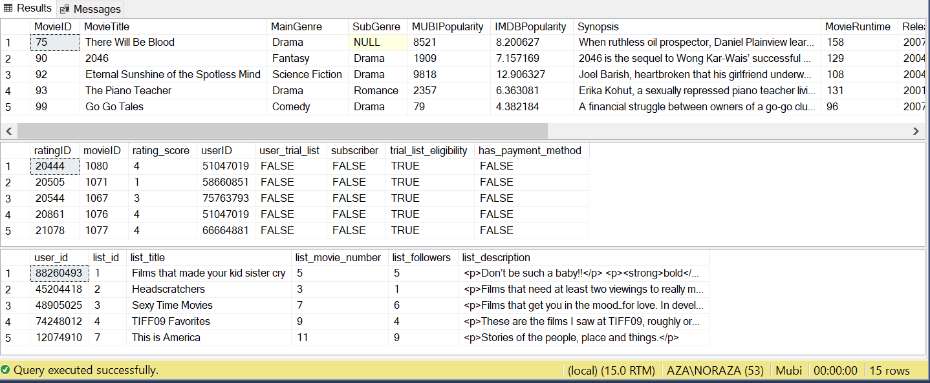
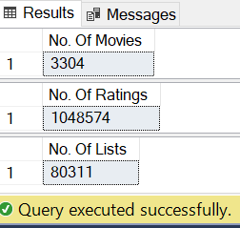

First Look
How many columns are there?
What are the column names?
How many records in the 3 tables?
--First look at the 3 tables
SELECT TOP 5 * FROM mubi.MovieCost;
SELECT TOP 5 * FROM mubi.ratings;
SELECT TOP 5 * FROM mubi.lists_data;
SELECT COUNT(*) AS 'No. Of Movies' FROM mubi.MovieCost;
SELECT COUNT (*) AS 'No. Of Ratings' FROM mubi.ratings;
SELECT COUNT (*) AS 'No. Of Lists' FROM mubi_lists_data;
SELECT MIN(YEAR(ReleaseDate)) AS [MIN YEAR], MAX(YEAR(ReleaseDate)) AS [MAX YEAR]
FROM mubi.MovieCost

Slide 14
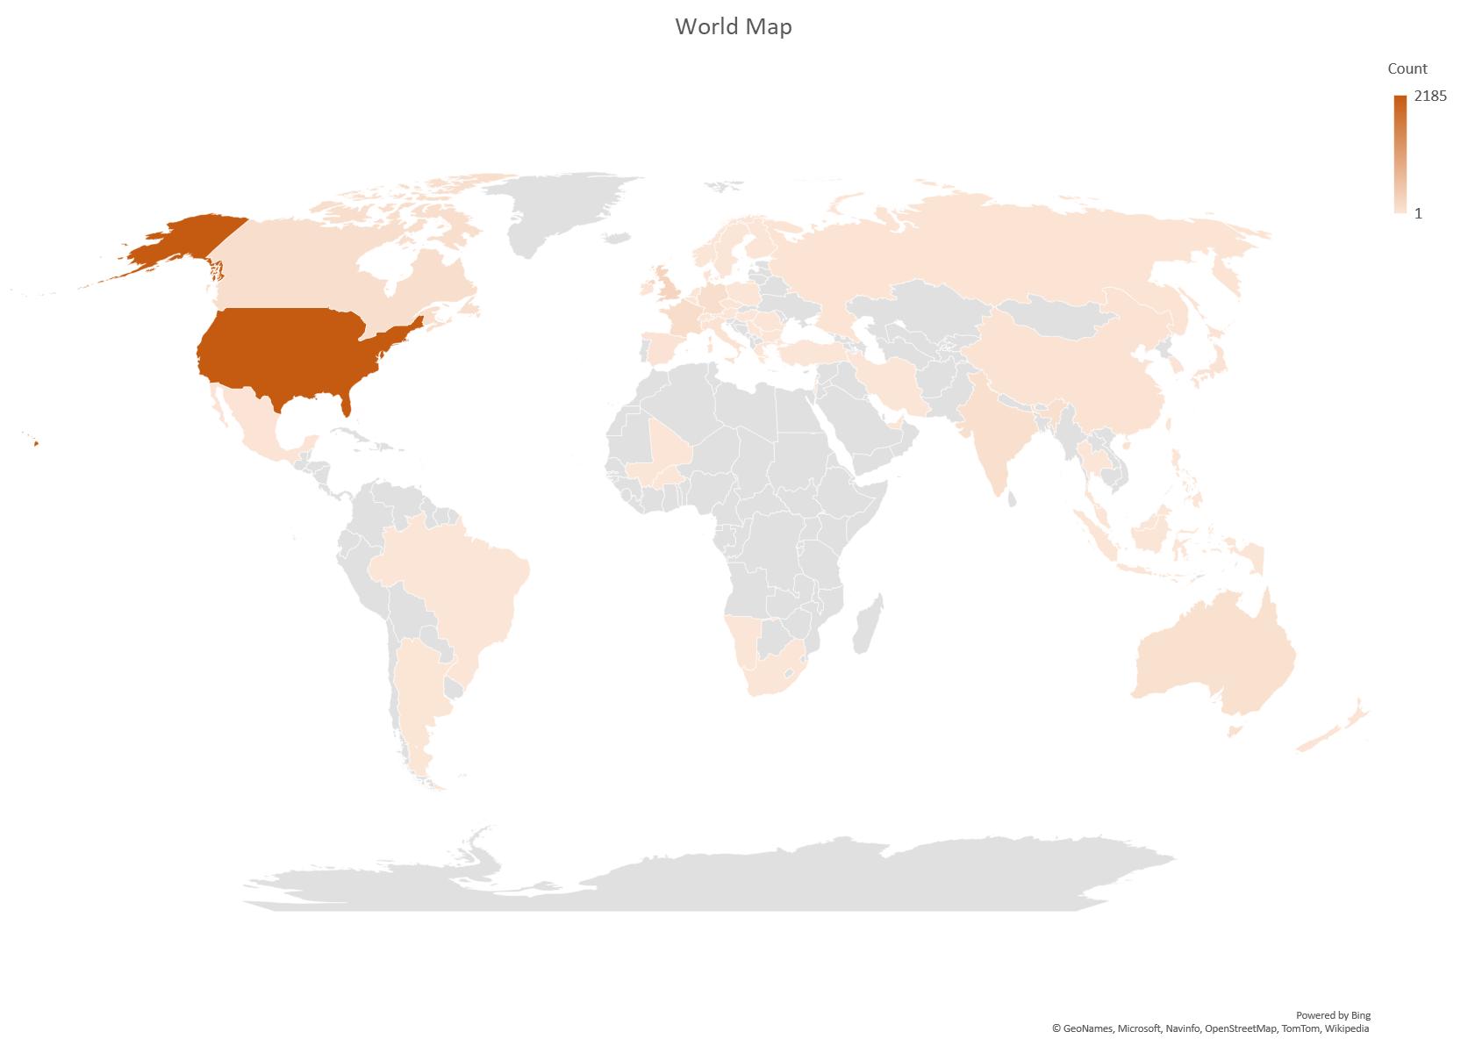
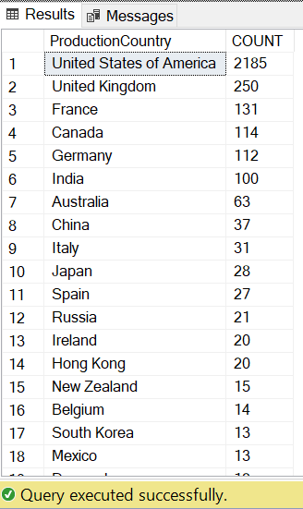
First Look
SELECT ProductionCountry, COUNT(ProductionCountry) AS COUNT
FROM mubi.MovieCost
GROUP BY ProductionCountry
ORDER BY 2 DESC;
Available movies in the MUBI catalogue are mostly produced in the WEST part of the world. Particularly in the USA!

Slide 15
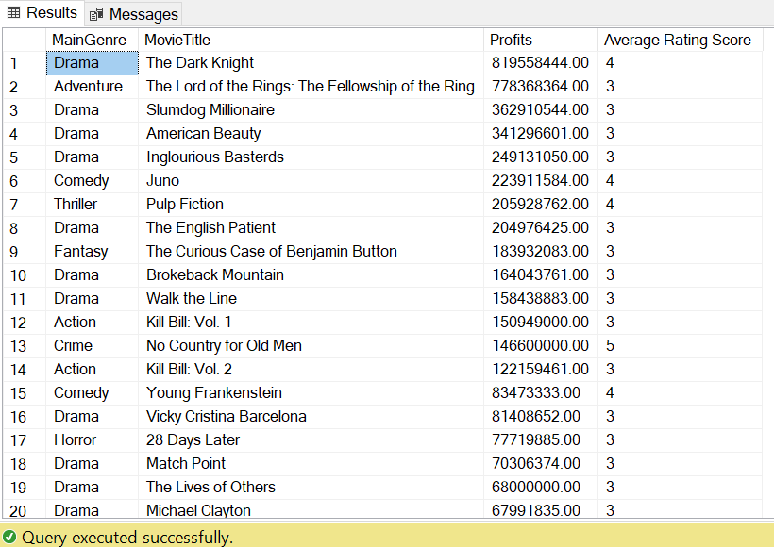
1. Which Movies have the highest profits & highest MUBI rating score?
SELECT TOP 50 MC.MovieTitle,
(MC.MovieRevenue - MC.MovieBudget) AS Profits,
AVG(ISNULL (R.rating_score,0)) AS [Average Rating Score]
FROM mubi.MovieCost AS MC
INNER JOIN mubi.ratings AS R
ON (MC.MovieID = R.movieID)
GROUP BY MC.MovieTitle,
MC.MovieRevenue - MC.MovieBudget
ORDER BY 2 DESC, 3 DESC;
DARK KNIGHT is the most profitable movie in the MUBI database
Let’s find out what makes a movie successful further into the presentation!

Slide 16
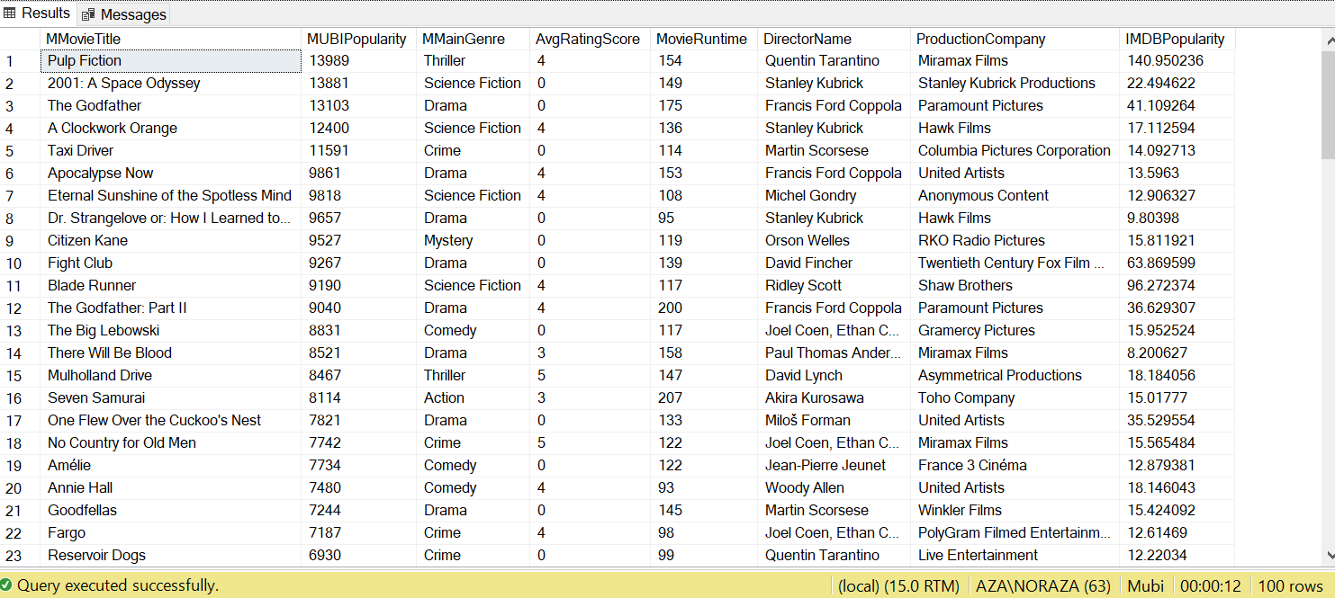
2. MUBI Customer’s TOP 100 Movie Preference
(Mubi Popularity)
a) WHAT ARE THE TOP 100 MOVIES WHICH ARE POPULAR AMONG THE MUBI SUBSCRIBERS?
SELECT TOP 100 topMUBI.MMovieTitle AS MovieTitle,
topMUBI.MUBIPopularity,
topMUBI.MMainGenre AS MainGenre,
ISNULL(topMUBI.AvgRatingScore, 0) AS AvgRatingScore,
topMUBI.MovieRuntime AS MovieRuntime,
topMUBI.DirectorName,
topIMDB.IMDBPopularity AS IMDBPopularity
FROM topMUBI
LEFT JOIN topIMDB
ON (topMUBI.MMovieTitle = topIMDB.IMovieTitle)
WHERE topIMDB.IMovieTitle IS NOT NULL
ORDER BY topMUBI.MUBIPopularity DESC

Slide 17
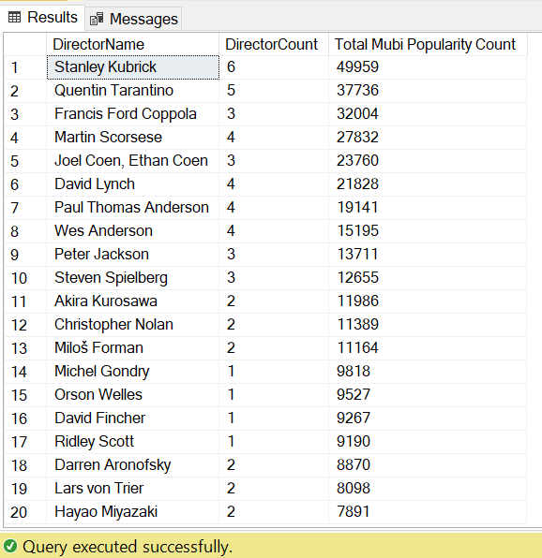
2. MUBI Customer’s TOP 100 Movie Preference
(Mubi Popularity)
(b) DirectorName vs NO OF SUCCESSFUL MOVIE FOR HIGHEST MUBI POPULARITY
WITH topMUBI_IMDB AS (
SELECT TOP 100 topMUBI.MMovieTitle AS MovieTitle,
topMUBI.MUBIPopularity,
topMUBI.MMainGenre AS MainGenre,
ISNULL(topMUBI.AvgRatingScore, 0) AS AvgRatingScore,
topMUBI.MovieRuntime AS MovieRuntime,
topMUBI.DirectorName,
topIMDB.IMDBPopularity AS IMDBPopularity
FROM topMUBI
LEFT JOIN topIMDB
ON (topMUBI.MMovieTitle = topIMDB.IMovieTitle)
WHERE topIMDB.IMovieTitle IS NOT NULL
ORDER BY topMUBI.MUBIPopularity DESC)
SELECT TOP 20 DirectorName,
COUNT(DirectorName) AS DirectorCount,
SUM(MUBIPopularity) AS [Total Mubi Popularity Count]
FROM topMUBI_IMDB
GROUP BY DirectorName
ORDER BY 3 DESC, 2 DESC;

Slide 18
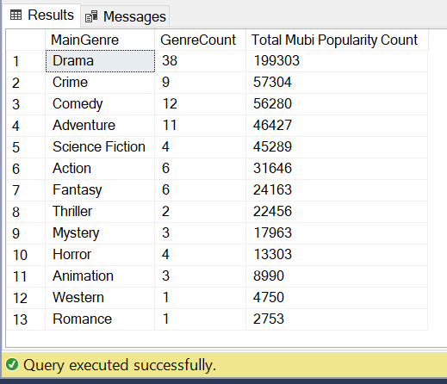
2. MUBI Customer’s Movie Preference
(Mubi Popularity)
c) MainGenre VS NO OF SUCCESSFUL MOVIE FOR HIGHEST MUBI POPULARITY
WITH topMUBI_IMDB AS (
SELECT TOP 100 topMUBI.MMovieTitle,
topMUBI.MUBIPopularity,
topMUBI.MMainGenre,
ISNULL(topMUBI.AvgRatingScore, 0) AS AvgRatingScore,
topMUBI.MovieRuntime,
topMUBI.DirectorName,
topMUBI.ProductionCompany,
topIMDB.IMDBPopularity AS IMDBPopularity
FROM topMUBI
LEFT JOIN topIMDB
ON (topMUBI.MMovieTitle = topIMDB.IMovieTitle)
WHERE topIMDB.IMovieTitle IS NOT NULL
ORDER BY topMUBI.MUBIPopularity DESC
)
SELECT MMainGenre AS MainGenre,
COUNT(MMainGenre) AS GenreCount,
SUM(MUBIPopularity) AS [Total Mubi Popularity Count]
FROM topMUBI_IMDB
GROUP BY MMainGenre
ORDER BY 3 DESC, 2 DESC;

Slide 19
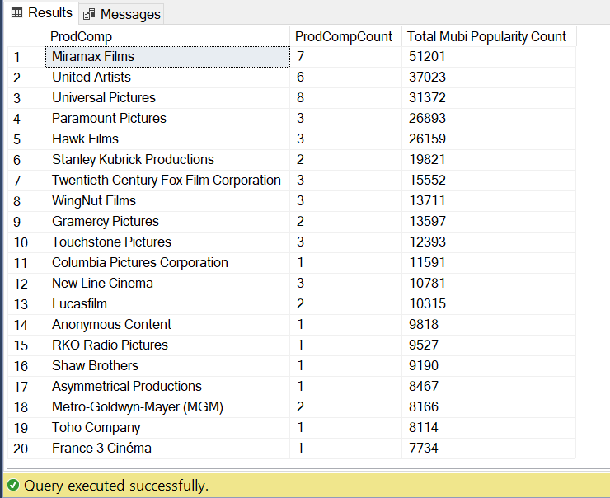
2. MUBI Customer’s Movie Preference
(Mubi Popularity)
d) PRODUCTION COMPANY VS NO OF SUCCESSFUL MOVIE FOR HIGHEST MUBI POPULARITY
WITH topMUBI_IMDB AS (
SELECT TOP 100 topMUBI.MMovieTitle AS MovieTitle,
AS topMUBI.MUBIPopularity,
topMUBI.MMainGenre MainGenre,
ISNULL(topMUBI.AvgRatingScore, 0) AS AvgRatingScore,
topMUBI.MovieRuntime AS MovieRuntime,
topMUBI.DirectorName,
topMUBI.ProductionCompany AS ProdComp,
topIMDB.IMDBPopularity AS IMDBPopularity
FROM topMUBI
LEFT JOIN topIMDB
ON (topMUBI.MMovieTitle = topIMDB.IMovieTitle)
WHERE topIMDB.IMovieTitle IS NOT NULL
ORDER BY topMUBI.MUBIPopularity DESC)
SELECT TOP 20 ProdComp,
COUNT(*) AS ProdCompCount,
SUM(MUBIPopularity) AS [Total Mubi Popularity Count]
FROM topMUBI_IMDB
GROUP BY ProdComp
ORDER BY 3 DESC, 2 DESC;

Slide 20
2. MUBI Customer’s Movie Preference
(Mubi Popularity)
e) MOVIE RUNTIME VS NO OF SUCCESSFUL MOVIE FOR HIGHEST MUBI POPULARITY
--View 2
CREATE VIEW topIMDB AS (
SELECT TOP 2930 MovieTitle AS IMovieTitle,
IMDBPopularity,
MainGenre AS IMainGenre
FROM mubi.MovieCost
ORDER BY 2 DESC);
--View 1
CREATE VIEW topMUBI AS (
SELECT TOP 2930 MC.MovieTitle AS MMovieTitle,
MC.MUBIPopularity,
MainGenre AS MMainGenre,
AVG(ISNULL(R.rating_score, 0) AS AvgRatingScore,
MC.MovieRuntime AS MovieRuntime,
MC.DirectorName AS DirectorName,
MC.ProductionCompany AS ProductionCompany
FROM mubi.MovieCost AS MC
LEFT JOIN mubi.ratings AS R
ON (MC.MovieID = R.movieID)
GROUP BY MC.MUBIPopularity,
MC.MovieTitle,
MainGenre,
MC.DirectorName,
MC.MovieRuntime,
MC.ProductionCompany
HAVING NOT MC.MUBIPopularity = '0’
OR NOT MC.MUBIPopularity IS NULL
ORDER BY 2 DESC);
--View 3
CREATE VIEW topMUBI_IMDB AS (
SELECT TOP 100 topMUBI.MMovieTitle,
topMUBI.MUBIPopularity,
topMUBI.MMainGenre,
topMUBI.AvgRatingScore,
topMUBI.MovieRuntime AS Runtime,
topMUBI.DirectorName,
topMUBI.ProductionCompany,
topIMDB.IMDBPopularity AS IMDBPopularity
FROM topMUBI
LEFT JOIN topIMDB
ON (topMUBI.MMovieTitle = topIMDB.IMovieTitle)
WHERE topIMDB.IMovieTitle IS NOT NULL
ORDER BY topMUBI.MUBIPopularity DESC);

Slide 21
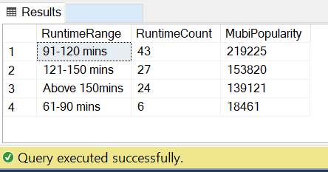
2. MUBI Customer’s Movie Preference
(Mubi Popularity)
e) MOVIE RUNTIME VS NO OF SUCCESSFUL MOVIE FOR HIGHEST MUBI POPULARITY
SELECT rr.RuntimeRange,
COUNT(*) AS RuntimeCount,
SUM(rr.MUBIPopularity) AS MubiPopularity
FROM (
SELECT TOP 100 Runtime, MUBIPopularity,
CASE
WHEN [Runtime] BETWEEN 0 AND 60 THEN '0-60 mins'
WHEN [Runtime] BETWEEN 61 AND 90 THEN '61-90 mins'
WHEN [Runtime] BETWEEN 91 AND 120 THEN '91-120 mins'
WHEN [Runtime] BETWEEN 121 AND 150 THEN '121-150 mins’
ELSE 'Above 150mins'
END AS [RuntimeRange]
FROM topMUBI_IMDB
ORDER BY topMUBI_IMDB.MUBIPopularity DESC) AS rr
GROUP BY RuntimeRange
ORDER BY 3 DESC;

Slide 22
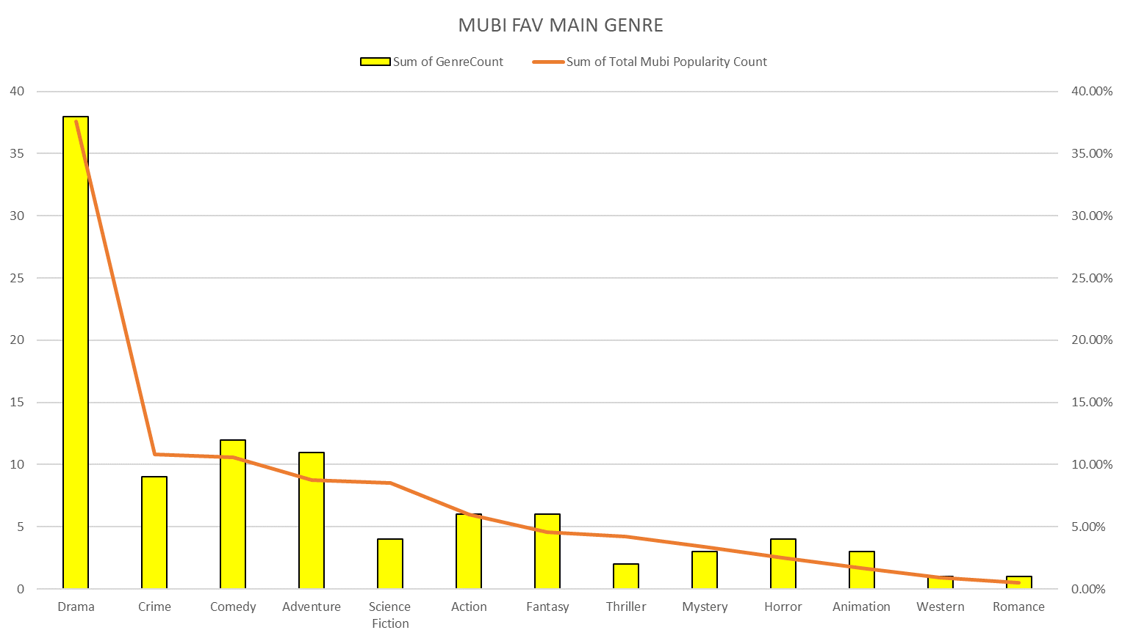
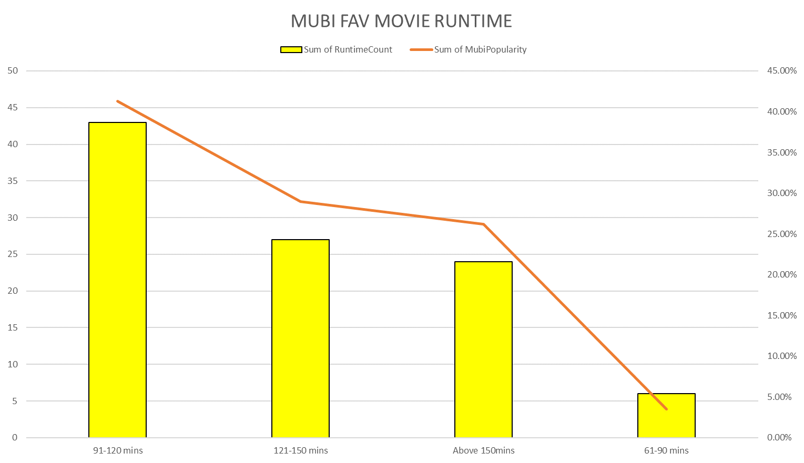
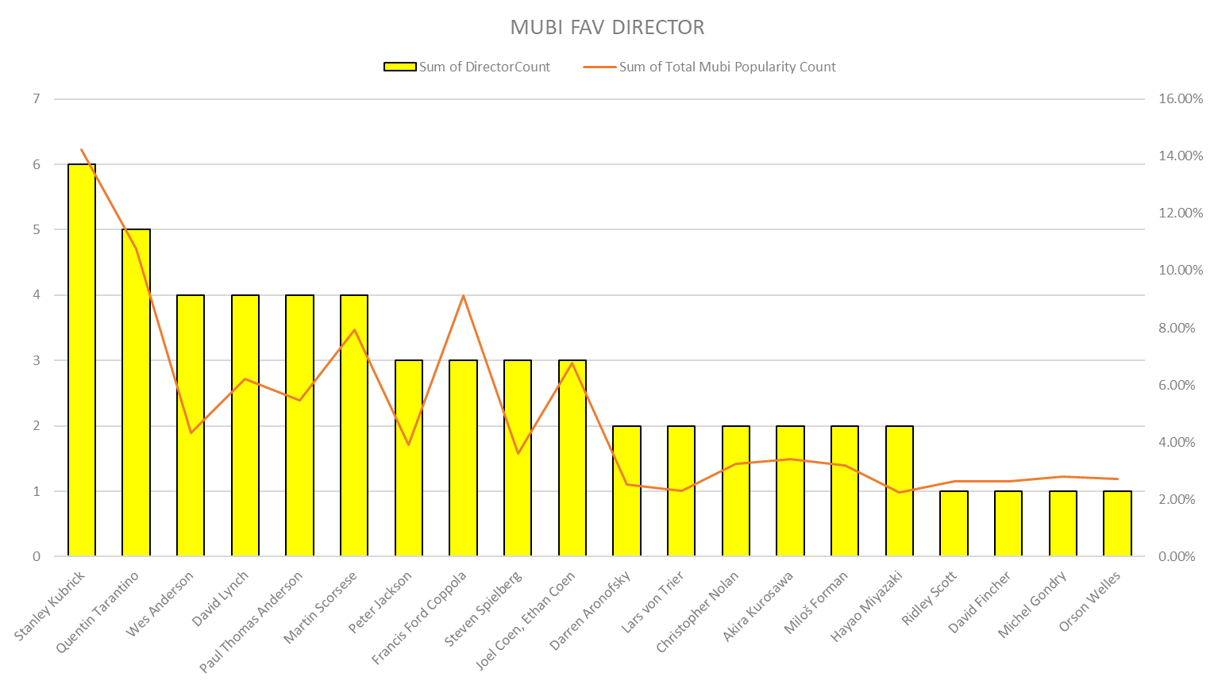
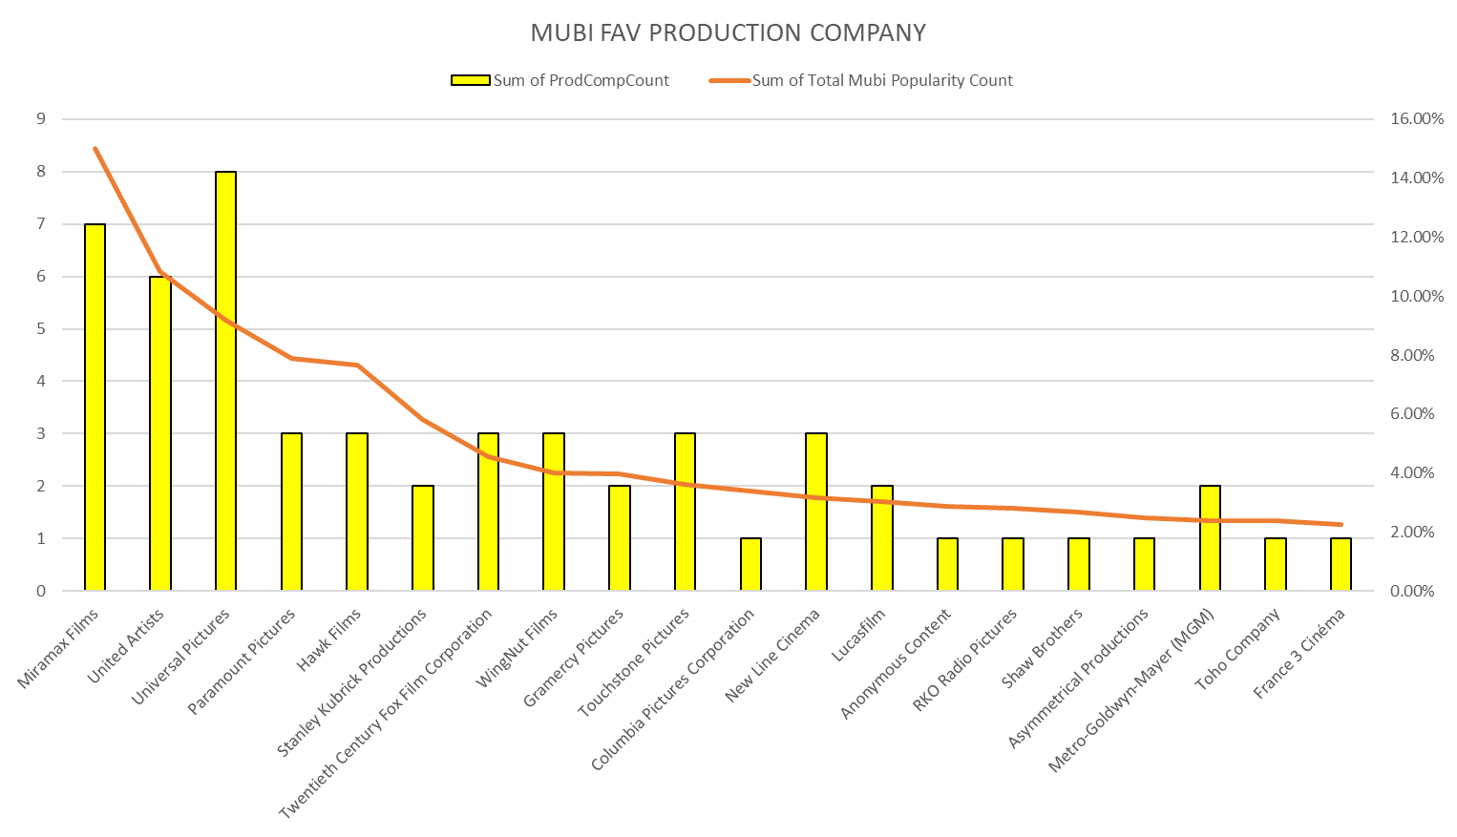
MUBI’s customers:
Director: Stanley Kubrick
Genre: Drama
Runtime: 91-120mins
Production Company: Miramex Films
→ Customer could be working adults or film enthusiasts who loves watching a good storyline

Slide 23
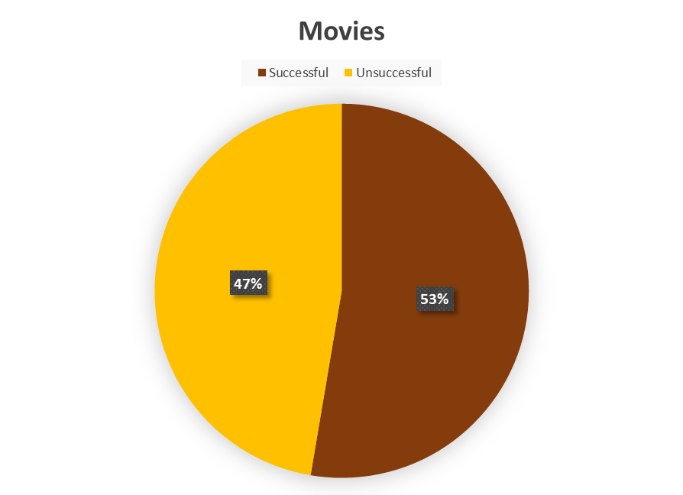
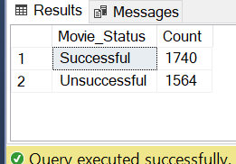
3. How many successful and unsuccessful movies?
A successful movie is defined as: Revenue = 2.0 Budget
--Create Function
CREATE FUNCTION mubi.mov_status
(@movst real)
RETURNS varchar (20)
AS
BEGIN
DECLARE @ename varchar (20);
IF @movst >= 2.0
SET @ename = 'Successful';
ELSE
SET @ename = 'Unsuccessful';
RETURN @ename
END;
--Query 1
SELECT mubi.mov_status(MovieRevenue/MovieBudget) AS Movie_Status,
COUNT(
CASE
WHEN mubi.mov_status(MovieRevenue/MovieBudget) >= 2.0 THEN '1'
ELSE '0'
END) AS Count
FROM mubi.MovieCost
GROUP BY mubi.mov_status(MovieRevenue/MovieBudget)
HAVING mubi.mov_status(MovieRevenue/MovieBudget) = 'Successful'
OR mubi.mov_status(MovieRevenue/MovieBudget) = 'Unsuccessful'

Slide 24
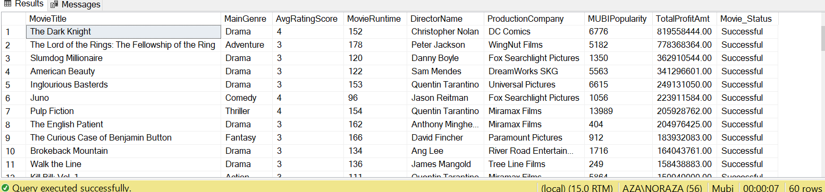
3. How many successful and unsuccessful movies?
Which movies are most successful in Mubi db?
SELECT MC.MovieTitle,
MC.MainGenre,
AVG(ISNULL(R.rating_score, 0)) AS AvgRatingScore,
MC.MovieRuntime,
MC.DirectorName,
MC.ProductionCompany,
MC.MUBIPopularity,
(MovieRevenue-MovieBudget) AS TotalProfitAmt,
mubi.mov_status(MovieRevenue/MovieBudget) AS Movie_Status
FROM mubi.MovieCost AS MC
INNER JOIN mubi.ratings AS R
ON (MC.MovieID = R.movieID)
GROUP BY MovieTitle,
(MovieRevenue-MovieBudget),
MC.MainGenre,
MC.MovieRuntime,
MC.DirectorName,
MC.ProductionCompany,
MC.MUBIPopularity,
MC.MovieRevenue,
MC.MovieBudget
HAVING mubi.mov_status(MovieRevenue/MovieBudget) = 'Successful'
ORDER BY 8 DESC

Slide 25
3. What makes a successful movie?
Explore 4 factors (Director, Main Genre, Movie Runtime, Production Company VS No. of successful movies
a) DIRECTOR vs NO OF SUCCESSFUL MOVIES
WITH total_status AS (
SELECT DirectorName,
mubi.mov_status(MovieRevenue/MovieBudget) AS [Successful Movies Count]
FROM mubi.MovieCost
),
successful_status AS (
SELECT DirectorName,
COUNT([Successful Movies Count]) AS [No. Of Successful Movies]
FROM total_status
WHERE [Successful Movies Count] = 'Successful'
GROUP BY DirectorName
),
count_dir AS (
SELECT DirectorName,
COUNT(DirectorName) AS [Total Movies Made]
FROM mubi.MovieCost
GROUP BY DirectorName
)
SELECT count_dir.DirectorName, count_dir.[Total Movies Made], successful_status.[No. Of Successful Movies]
FROM count_dir
INNER JOIN successful_status
ON count_dir.DirectorName = successful_status.DirectorName
ORDER BY count_dir.[Total Movies Made] DESC, successful_status.[No. Of Successful Movies] DESC

Slide 26
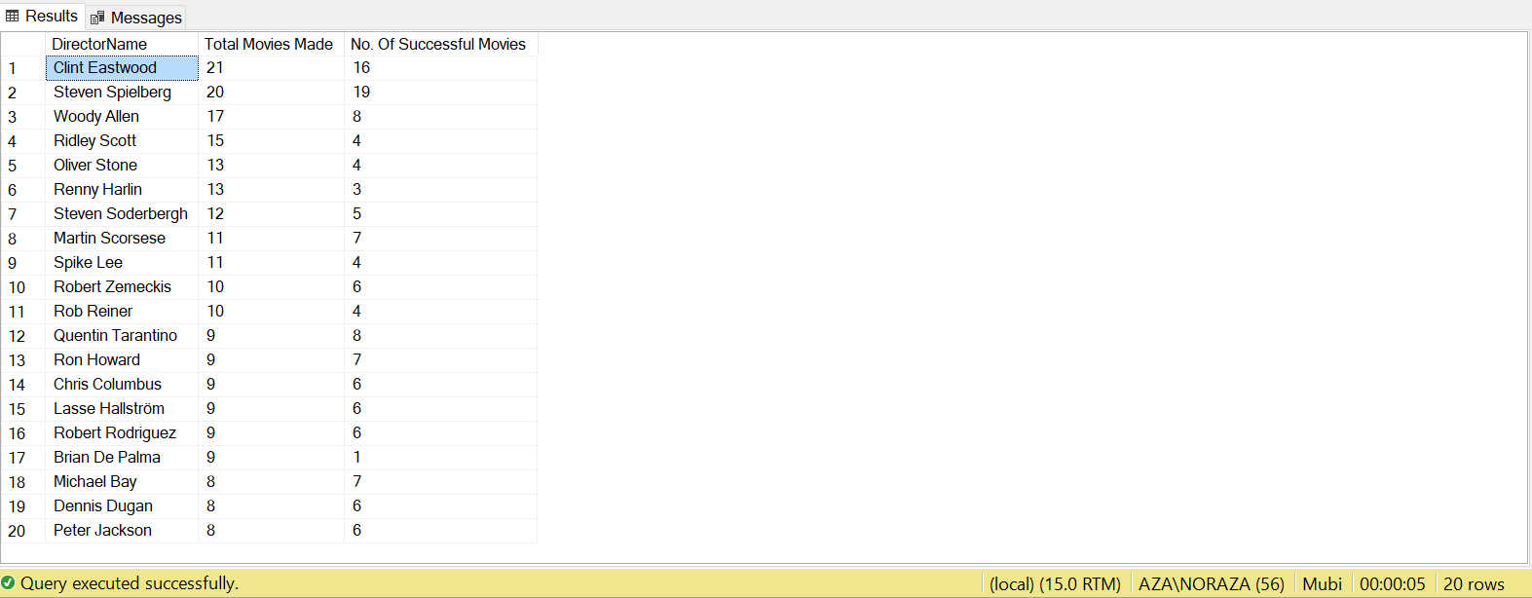
3. What makes a successful movie?
Explore 4 factors (Main Genre, Movie Runtime, Director, Production Company VS No. of successful movies
a) DIRECTOR vs NO OF SUCCESSFUL MOVIES

Slide 27
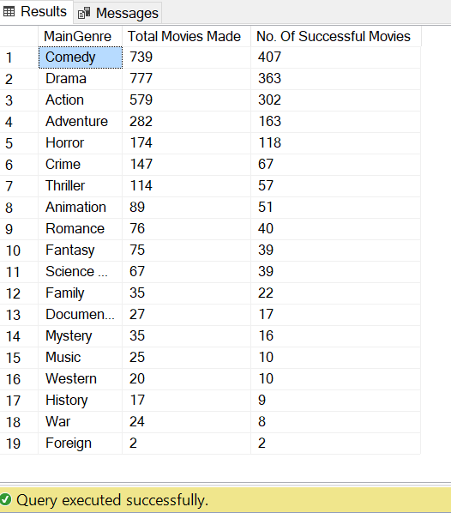
3. What makes a successful movie?
Explore 4 factors (Main Genre, Movie Runtime, Director, Production Company VS No. of successful movies)
---MainGenre vs NO OF SUCCESSFUL MOVIE
WITH total_statusMG AS (
SELECT MainGenre,
mubi.mov_status(MovieRevenue/MovieBudget) AS [Successful Movies Count]
FROM mubi.MovieCost
),
successful_statusMG AS (
SELECT MainGenre,
COUNT([Successful Movies Count]) AS [No. Of Successful Movies]
FROM total_statusMG
WHERE [Successful Movies Count] = 'Successful'
GROUP BY MainGenre
),
count_MG AS (
SELECT MainGenre,
COUNT(DirectorName) AS [Total Movies Made]
FROM mubi.MovieCost
GROUP BY MainGenre
)
SELECT count_MG.MainGenre, count_MG.[Total Movies Made], successful_statusMG.[No. Of Successful Movies]
FROM count_MG
INNER JOIN successful_statusMG
ON count_MG.MainGenre = successful_statusMG.MainGenre
ORDER BY count_MG.[Total Movies Made] DESC, successful_statusMG.[No. Of Successful Movies] DESC

Slide 28
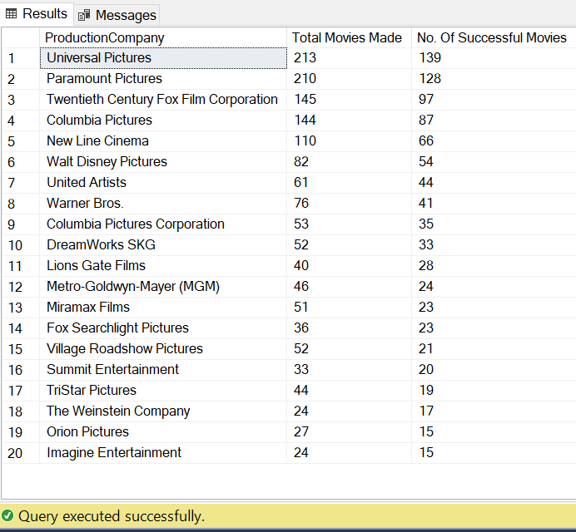
3. What makes a successful movie?
Explore 4 factors (Main Genre, Movie Runtime, Director, Production Company VS No. of successful movies)
--Production Company vs NO OF SUCCESSFUL MOVIE
WITH total_statusPDC AS (
SELECT ProductionCompany,
mubi.mov_status(MovieRevenue/MovieBudget) AS [Successful Movies Count]
FROM mubi.MovieCost
),
successful_statusPDC AS (
SELECT ProductionCompany,
COUNT([Successful Movies Count]) AS [No. Of Successful Movies]
FROM total_statusPDC
WHERE [Successful Movies Count] = 'Successful'
GROUP BY ProductionCompany
),
count_PDC AS (
SELECT ProductionCompany,
COUNT(ProductionCompany) AS [Total Movies Made]
FROM mubi.MovieCost
GROUP BY ProductionCompany
)
SELECT count_PDC.ProductionCompany, count_PDC.[Total Movies Made], successful_statusPDC.[No. Of Successful Movies]
FROM count_PDC
INNER JOIN successful_statusPDC
ON count_PDC.ProductionCompany = successful_statusPDC.ProductionCompany
ORDER BY count_PDC.[Total Movies Made] DESC, successful_statusPDC.[No. Of Successful Movies] DESC

Slide 29
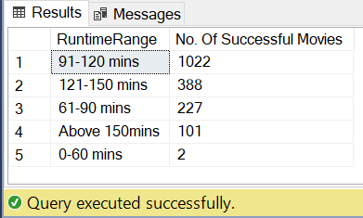
3. What makes a successful movie?
Explore 4 factors (Main Genre, Movie Runtime, Director, Production Company VS No. of successful movies
--MovieRuntime vs NO OF SUCCESSFUL MOVIE
WITH count_successfulRun AS (
SELECT MovieRuntime,
mubi.mov_status(MovieRevenue/MovieBudget) AS [Successful Movies Count]
FROM mubi.MovieCost
)
SELECT aa.RuntimeRange, COUNT(*) AS [No. Of Successful Movies]
FROM (
SELECT MovieRuntime, [Successful Movies Count],
CASE
WHEN [MovieRuntime] BETWEEN 0 AND 60 THEN '0-60 mins'
WHEN [MovieRuntime] BETWEEN 61 AND 90 THEN '61-90 mins'
WHEN [MovieRuntime] BETWEEN 91 AND 120 THEN '91-120 mins'
WHEN [MovieRuntime] BETWEEN 121 AND 150 THEN '121-150 mins'
ELSE 'Above 150mins'
END AS [RuntimeRange]
FROM count_successfulRun) AS aa
WHERE aa.[Successful Movies Count] = 'Successful'
GROUP BY RuntimeRange
ORDER BY 2 DESC;

Slide 30
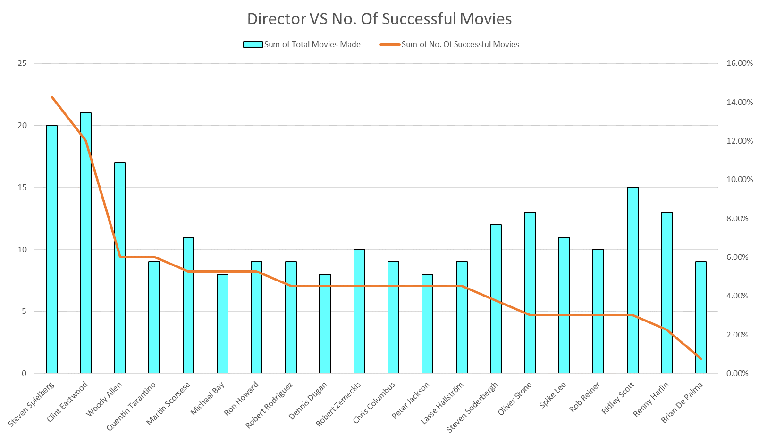
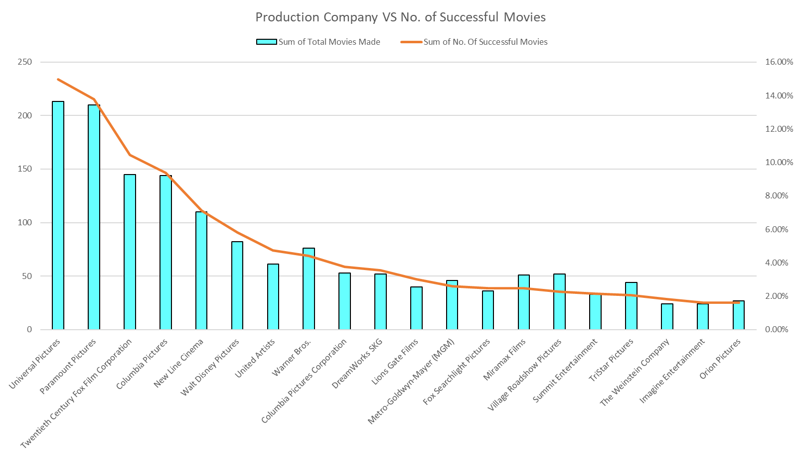
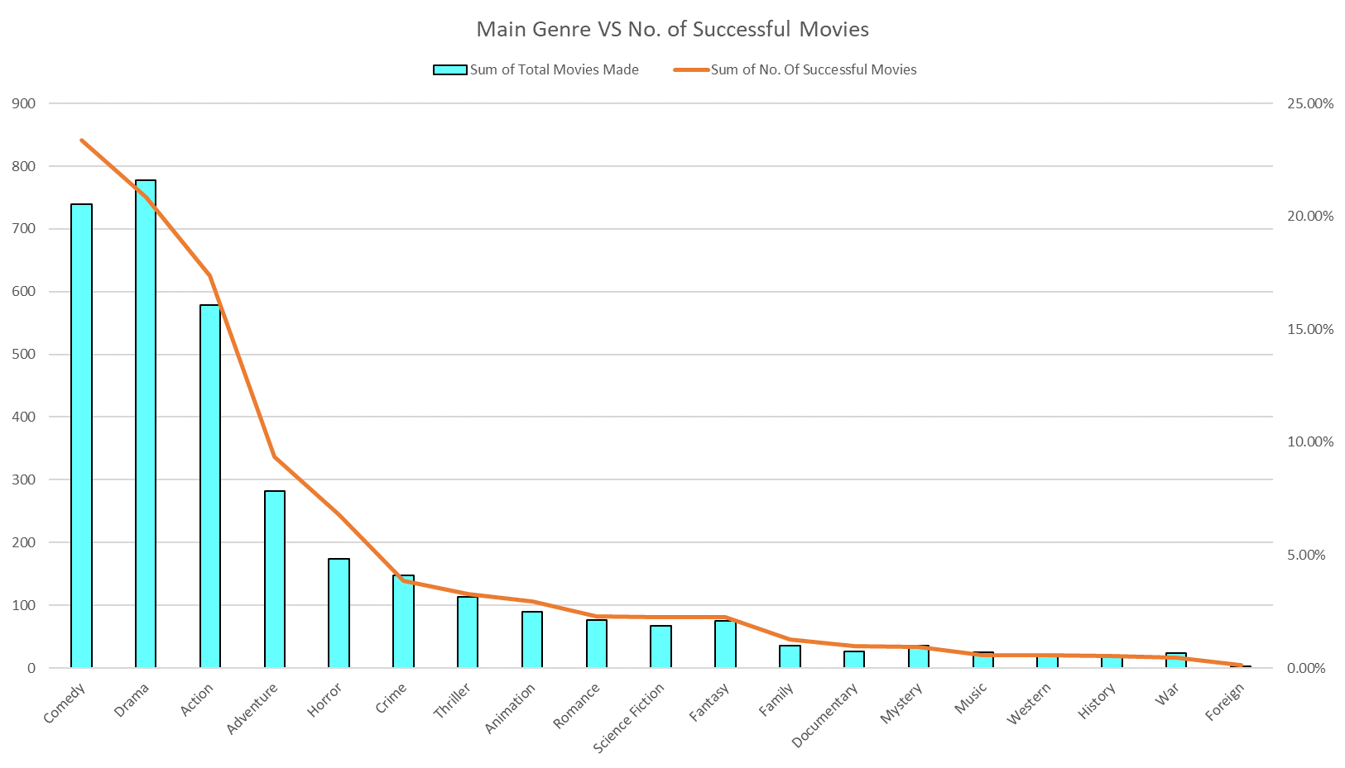
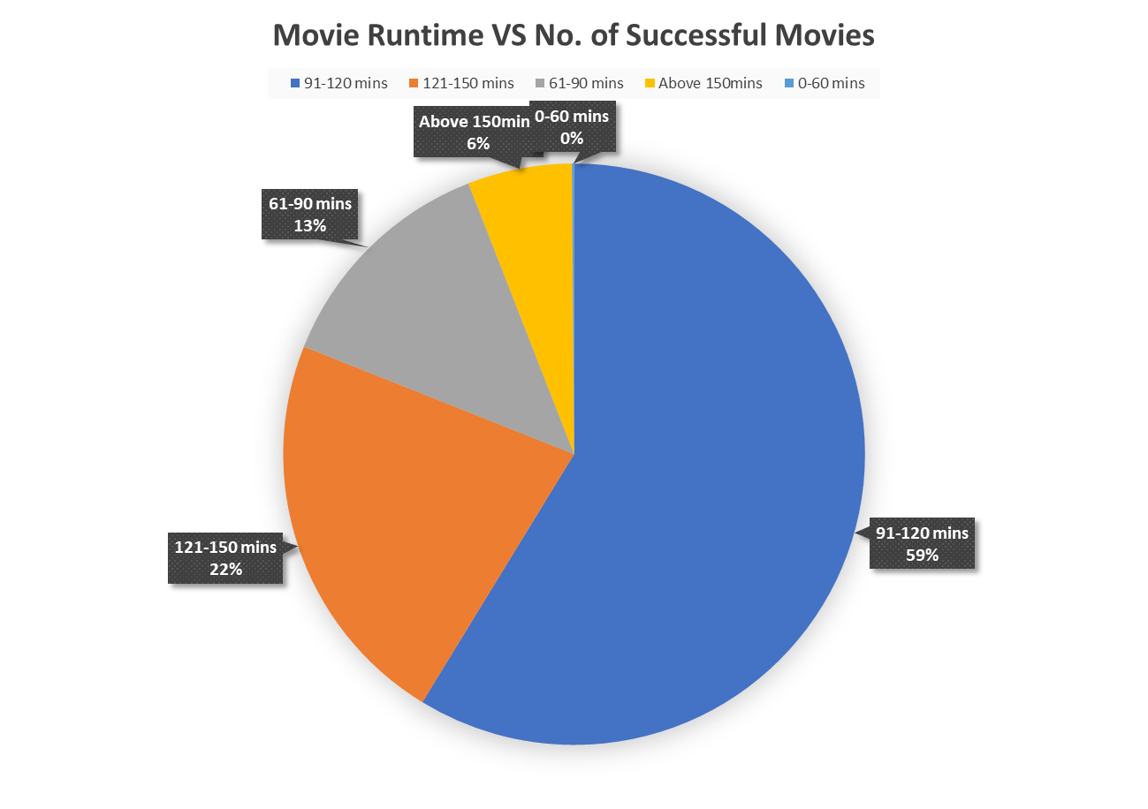
To make TOP successful movie:
Director: Steven Spielberg
Genre: Comedy
Runtime: 91-120mins
Production Company: Universal Pictures

Slide 31
EXCEL DASHBOARD

Slide 32
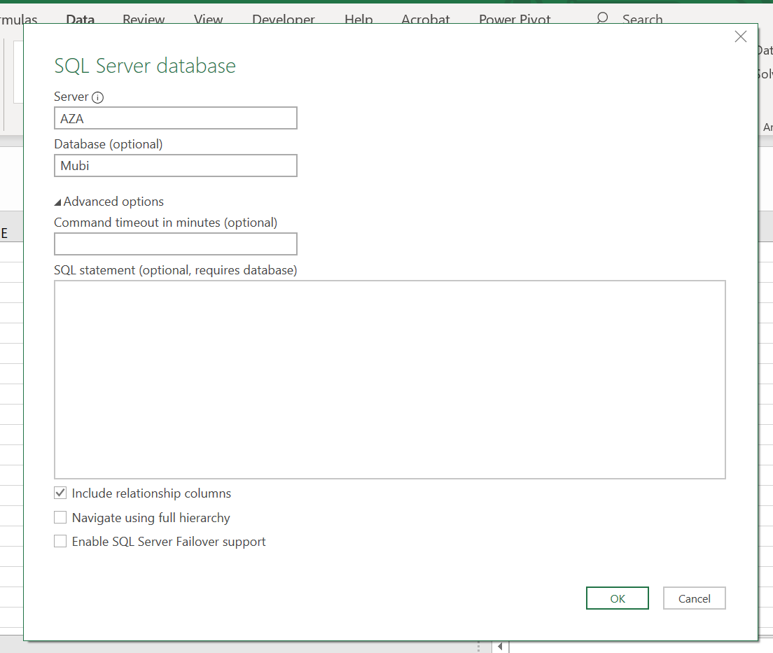
Importing data into excel

Slide 33
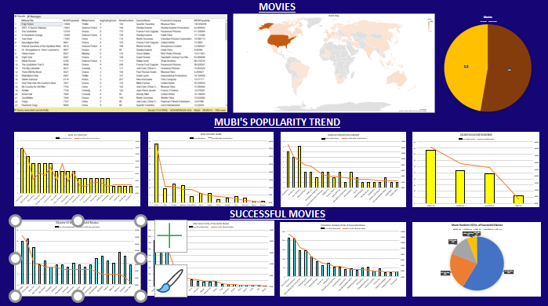

Slide 34
CONCLUSION

Slide 35
For MUBI:
Customers could be working adults or film enthusiasts who loves watching a good storyline.
→ As there is no customer demographic data available, a recommendation to increase subscribers would be to include more movies in the middle range from the Genre/Director/Production Company having runtime 91-120mins to include different occupations and ages.
.
For budding film makers, part of the formula of having the NO.1 successful movie production would have following characteristics:
Director: Steven Spielberg
Genre: Comedy
Runtime: 91-120mins
Production Company: Universal Pictures
Of course, there are other factors involved like an excellent script plays a major part too! Also, for a budding film maker, it would be costly to get Steven Spielberg as your director, so we can also look into other attributes!
Recommendation for future analysis:
Include how the casts involved affects the success rate as well

Slide 36

ANY QUESTIONS?
Nor Aza Hussain
16/11/2020
01
01
Credit: http://clipart-library.com/free/movie-slate-png.html

